Slide 1
POWER PLANT ENGINEERING
INTRODUCTION

Slide 2
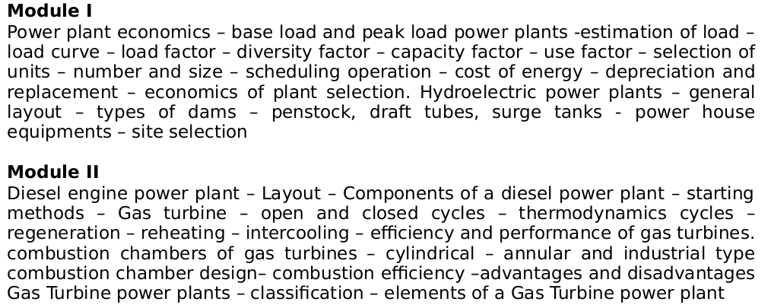
SYLLABUS

Slide 3
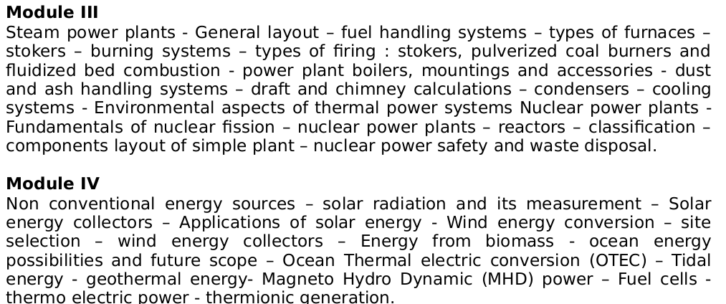
SYLLABUS-2

Slide 4
POWER
Definition of Power
Power is the time rate at which work is done or energy is transferred. In calculus terms, power is the derivative of work with respect to time.
Work= Force X Distance
= FXd
Unit of work in SI System is Joule (N-m)
Power=work/time=N-m/s=watt

Slide 5
ENERGY
Capacity to do work
Unit of Energy is the same as unit of work
In SI system-Joule

Slide 6
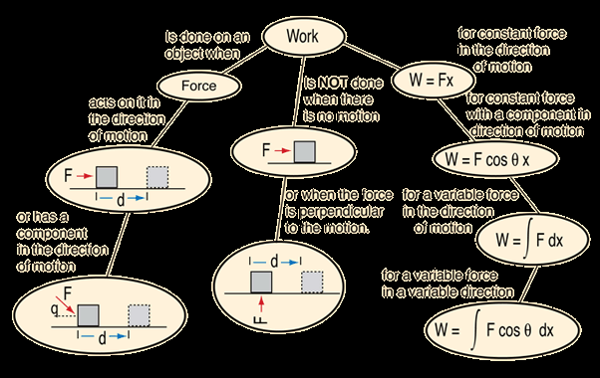
WORK

Slide 7
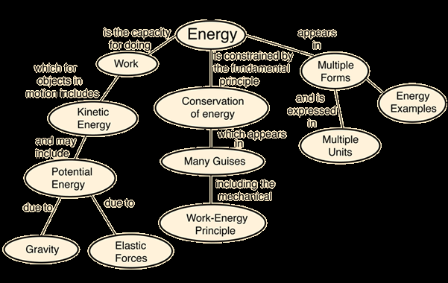
ENERGY

Slide 8
WORK, ENERGY AND POWER
Work-refers to an activity involving a force and movement in the direction of the force. A force of 20 N pushing an object 5 meters in the direction of the force does 100 joules of work.
Energy-is the capacity for doing work. You must have energy to accomplish work - it is like the "currency" for performing work. To do 100 joules of work, you must expend 100 joules of energy.
Power-is the rate of doing work or the rate of using energy, which are numerically the same. If you do 100 joules of work in one second (using 100 joules of energy), the power is 100 watts.

Slide 9
Power-2
Units of Power
Power=Work Done/time
W=F X Distance/time
W=N-M/s=J/s=Watt
One KW=1000W
One MW=1000KW
Horsepower is a unit of power in the British system of measurement.
One HP=746(745.699872 W) watts, assuming that a horse can move a mass of 746 KG to one meter in one second or 1492 KG to one meter in 2 secs. Usain bolt can run 100 min 9.58 secs. It is calculated that he expends 81.58 KJ of Energy during the run.
Trained athletes can develop upto 2.5 HP.

Slide 10
Power-3 History of the Unit
Development of steam engine(1770) necessitated the comparison with power generated by horses
33000 lbs-ft/min=one hp(optimistic)(A marketing tool)=550 ft·lbf/s
Or given that 1 hp = 550 ft·lbf/s, 1 ft = 0.3048 m, 1 lbf ≈ 4.448 N, 1 J = 1 N·m, 1 W = 1 J/s: 1 hp = 746 W

Slide 11
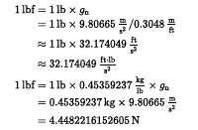

Slide 12
Units of power
The following definitions have been widely used:
Mechanical horsepower
hp(I) ≡ 33,000 ft-lbf/min
= 550 ft·lbf/s
= 745.699872 W
Metric horsepower
hp(M) ≡ 75 kgf·m/s
≡ 735.49875 W
Electrical horsepower
hp(E) ≡ 746 W
Boiler horsepower
hp(S) ≡ 33,475 BTU/h
= 9,809.5 W
Hydraulic horsepower = flow rate (US gal/min) × pressure (psi) × 7/12,000
or
= flow rate (US gal/min) × pressure (psi) / 1714
= 550 ft·lbf/s
= 745.699872 W

Slide 13
Power & Energy-1
Calorie-the amount of energy required to warm one gram water from by one °C at standard atmospheric pressure.(One Kcal=One Kg by One deg)
One Kcal=4.2 KJ
Calorific value of diesel =10800cal/gm=45 KJ/gm
To move a bus(16 tone) by one meter considering efficiency 30-35 % -one gm of diesel is required

Slide 14
Electrical Energy-1
Difference between KW,KWh & KVA
KW is unit of power
KWh is unit of Energy(Calorie,Joule ,wh etc are units of energy)
Energy=Power X Time
Unit of Cost Electrical energy sold is Rs/KWHr or simply Rs/unit-which is as low as Rs4 /unit in Kerala
To pump water using a 1 HP motor to fill a 1000 ltr capacity tank from a depth of 10 meters ,what is the cost & time?

Slide 15
Electrical Energy-2
Total work done= 1000X10X9.8 N-M=98000 N-M
Time taken=98000/746=131 secs
Considering efficiency of pump at 75% and power factor of .65 for the pump,time to be taken=268 secs=4.47 approx 5mins=.083 hr
Cost= .746X.083=0.062 Kwhr
Cost of 1 unit=Rs5=500 paise
Cost of .062 units=500X.062=31 paise

Slide 16
KW & KVA
The capacity of generators are indicated as KVA
Power factor
Demand
or example, to get 1 kW of real power, if the power factor is unity, 1 kVA of apparent power needs to be transferred (1 kW ÷ 1 = 1 kVA). At low values of power factor, more apparent power needs to be transferred to get the same real power. To get 1 kW of real power at 0.2 power factor, 5 kVA of apparent power needs to be transferred (1 kW ÷ 0.2 = 5 kVA). This apparent power must be produced and transmitted to the load in the conventional fashion, and is subject to the usual distributed losses in production.

Slide 17
Power plants
Eg- 100 cc bike
How its capacity usual specified
Bajaj Discover DTS-Si 100 specifications are
94.38cc engine, 7.5 BHP of power @ 7500 rpm and 7.85 Nm @ 5000 rpm
BHP=2∏NT/60
Lower gears more torque than power(A 2:1 gearbox halves BHP and doubles Torque, a 3:1 thirds and trebles, a 1:2 doubles and halves)

Slide 18
Torque
Torque, moment or moment of force (see the terminology below), is the tendency of a force to rotate an object about an axis, fulcrum, or pivot. Just as a force is a push or a pull, a torque can be thought of as a twist to an object. Mathematically, torque is defined as the product of force and the lever-arm distance, which tends to produce rotation
HP=TorqueXRPM/5252

Slide 19
Power Plant Capacities
Common I C engine generators
5KVA to 2.8 KVA Honda Genset
Petrol/Kerosene/ LPG
7 KW to 16000KW caterpillar Diesel Genset

Slide 20
Power Capacities of Devices-1
60W light bulb - 60W
100W light bulb - 100W
Microwave : 600-1500W
Washing Machine : 500W
Vacuum Cleaner : 200-700W
Iron : 1000W
Ceiling Fan : 50-60W
Laptop Computer : 20-50W
Desktop Computer : 80-150W
TV (19" colour) : 70W
Clock radio : 1W
Fridge : 500W
25" colour TV : 150W
Over head water pump-375 to 750 W
Thermal radiation emitted by a human body- 100W

Slide 21
Power Capacities of Devices-2
Mobile Phone=1-3 W
Usb drive .5-2 W
Maximum output from a UMTS/3G mobile -125 mW
Bluetooth Class 2 radio, 10 m range-2.5mW
Typical Wireless LAN transmission power in laptops 32 mW

Slide 22
Power Capacities of Devices-1
Bike-7-10 BHP
Car50-120 BHP
Bus-160-200 BHP
Train Engine-3000-7000 HP
Cruise Ship-50000-125000 BHP
Nuclear Submarine-50000-80000 HP

Slide 23
Energy Requirement World
According to calculations by the World Energy Council (WEC), the world-wide energy consumption currently is about 14 billion oil equivalent per year .
(One Litre of Oil=4.2 MJ)
One Ton oil=1 GJ(Approx)

Slide 24
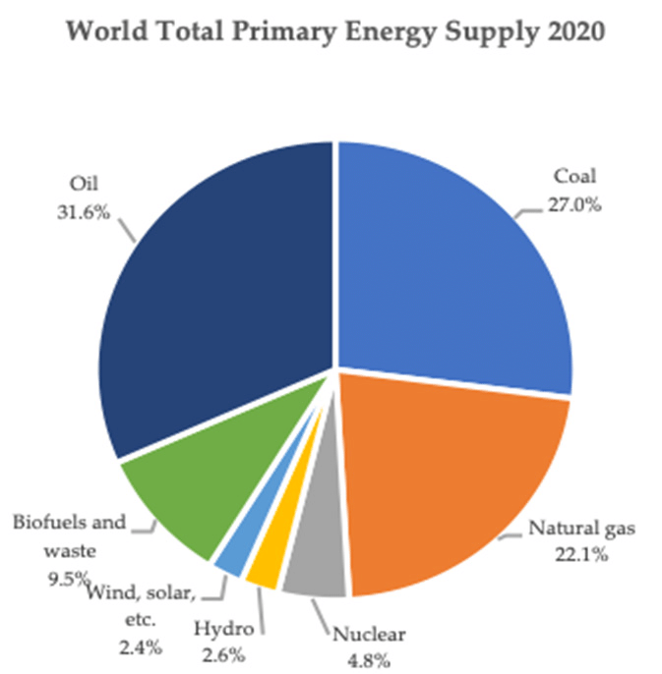

Slide 25
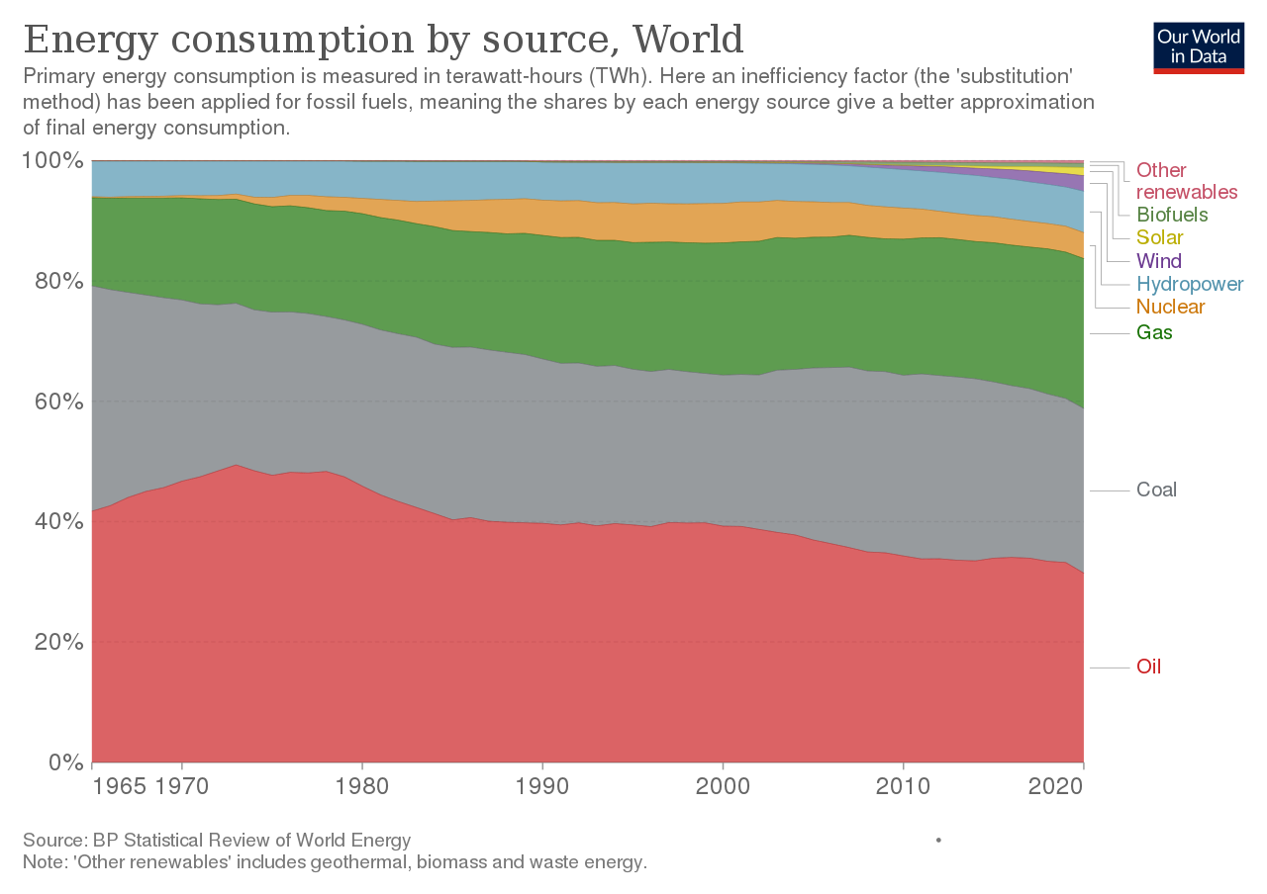

Slide 26
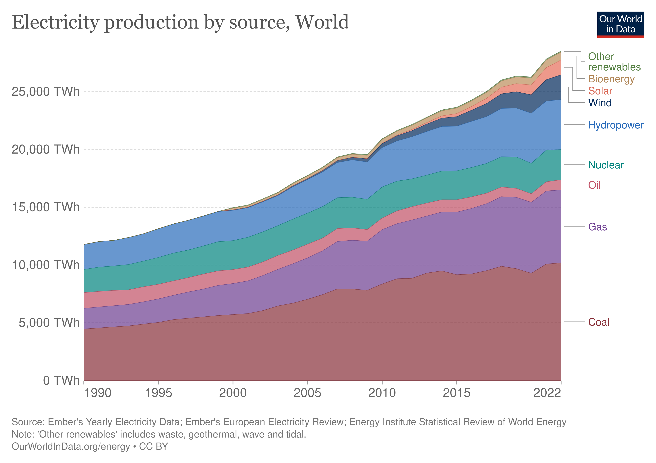
ELECTRICITY PRODUCTION BY SOURCE (1 Terra Watt=10**6 watts

Slide 27
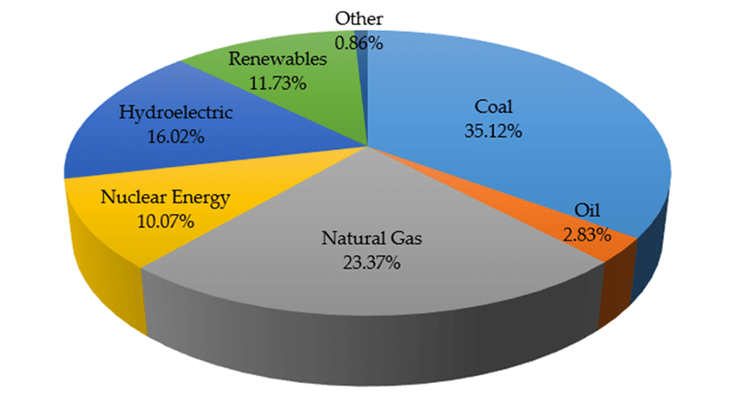
WORLD ELECTRICITY

Slide 28
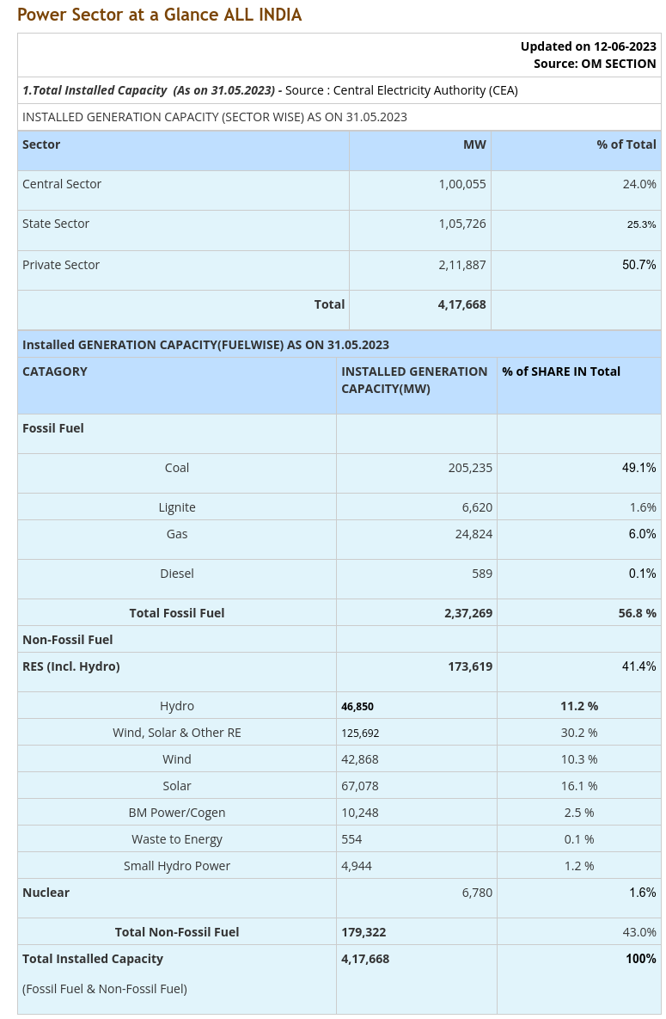

Slide 29
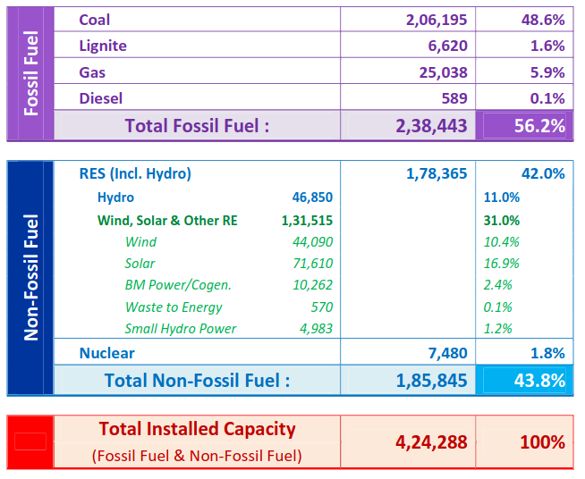

Slide 30
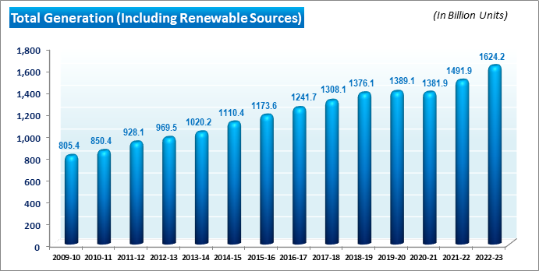

Slide 31
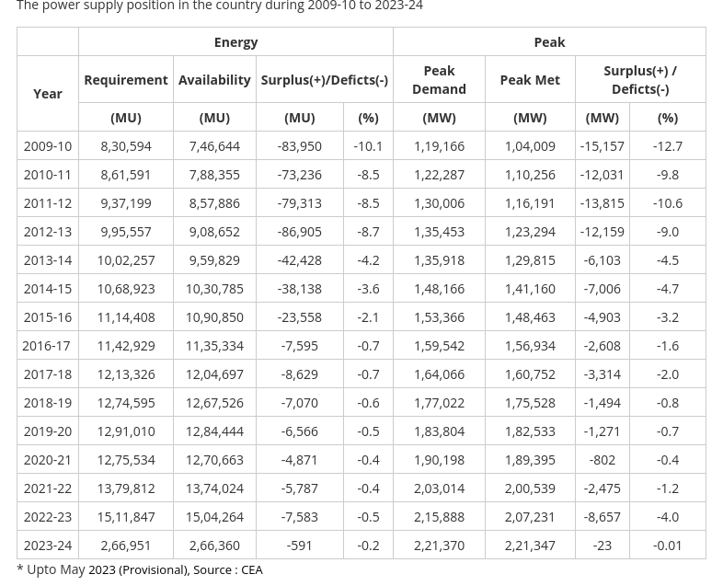

Slide 32
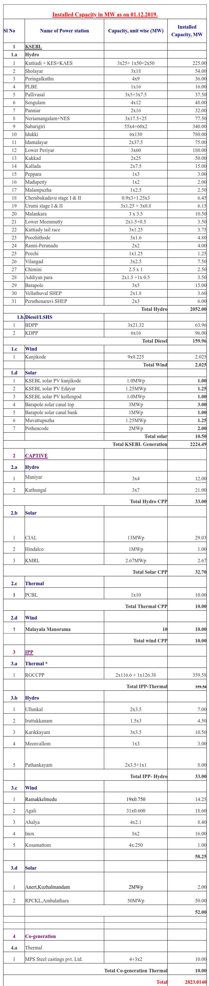

Slide 33
Kerala Energy Scenario
Total Installed Capacity
KSEB-2823MW
Centre -359 MW
Private-527 MW
Total-3709
Peak Load Requirement-4568MW
In 2021-22
Energy Produced -10516 MU
Energy Bought from Outside-18402 MU
Total-28918 MU

Slide 34
Where do we get this Energy?
There are only two sources of energy
1.Solar Energy-1300w/sqm-5.5 million Exajoules [EJ/y](EJ=10**18 Joules)
2.Gravitational Energy-2.24 · 10 **32J
3.Nuclear Fuels-Uranium-235 , Plutonium-239 etc

